Slide 1
HARMONISED EUROPEAN SOLUTIONS
FOR TESTING AUTOMATED ROAD TRANSPORT

Slide 2
Outline
HEADSTART project facts
HEADSTART Consortium
Overview
Project’s concept
Project’s objectives
Work Package Structure
Test sites
Expected Technical Results up to M12
Expected impact
Cooperate with HEADSTART project
HEADSTART Partners
Stay connected with HEADSTART

Slide 3



HEADSTART project facts
Call identifier: ART-01-2018
Type: RIA
Duration: 01.2019 – 12.2021 (36 months)
Budget: 6M€
Consortium: 17 partners
Coordinator: Applus IDIADA, Mr. Álvaro Arrue, Project Manager
Dissemination Manager: ICCS, Dr. Angelos Amditis, Research Director
Website: https://www.headstart-project.eu
Social media:
/ HEADSTART_EU
/ HEADSTART-PROJECT
/ HEADSTART project
/ @HeadstartEUproject

Slide 4
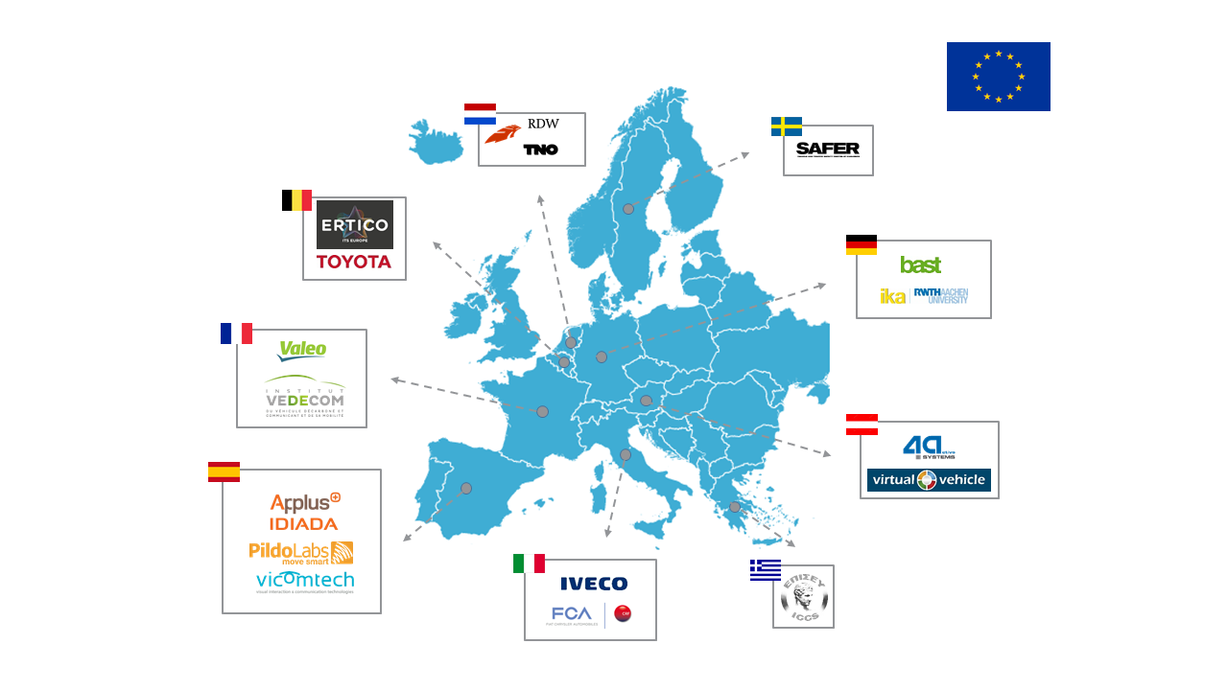
HEADSTART Consortium

Slide 5
Overview
The HEADSTART project:
aims to define testing and validation procedures of Connected and Automated Driving functions including key technologies such as communications, cyber-security and positioning;
will execute tests which will be in both simulation and real-world fields to validate safety and security performance according to the key users’ needs;
will bring together the consortium with other European and national CAD stakeholders to cluster the most relevant existing initiatives, develop methodologies, procedures and tools and drive in a harmonized European solution for testing and validation of automated road vehicles;
will address relevant stakeholders to join the experts’ network so as to configure together the methodologies used and also promote the project results’ adoption.

Slide 6
Project’s Concept
Integration of positioning, communications and cyber-security in CAD test scenarios
Correlation between simulation and proving ground results
Comprehensive procedure for the allocation of test cases per testing platform
Harmonised, open result compilation and sharing
Selection criteria and specification for proving ground test scenarios taking into account criticality
Field trial test methodology description
Proving ground testing and evaluation
Cyber-security principles and integration in the testing methodology

Slide 7
Project’s Objectives
HEADSTART will define testing and validation procedures of CAD functions including:
  its key enabling technologies (i.e. communication, cyber-security, positioning)
  by cross-linking of all test instances such as simulation, proving ground and real world field tests
  to validate safety and security performance according to the needs of key user groups (technology developers, consumer testing and type approval)

Slide 8
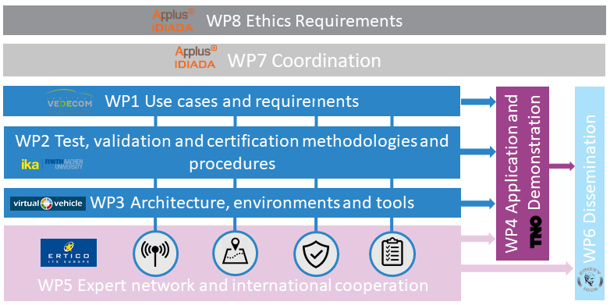
Work Package Structure

Slide 9





Test sites
IDIADA test site, Spain
LELYSTADT test site, the Netherlands
Aldehnoven test site, Germany
AstaZero test site, Sweden
DITCM test site, the Netherlands

Slide 10
Expected Technical Results up to M12
List of Deliverables M1 – M12
Del. No. | Deliverable Title | Lead Beneficiary | Due Date | Rev1 | Rev2
D1.1 | State of innovation of existing initiatives and gap analysis | IKA | M6 | TNO | TNO
D1.2 | Stakeholders and user group needs | VEDECOM | M6 | IDI | ERTICO
D1.3 | Technical and functional requirements for KETs | SAFER | M9 | VICOMTECH | IVECO
D1.4 | Functional requirements of selected use cases | SAFER | M9 | VIF | ika
D2.1 | Common methodology for test, validation and certification | IKA | M12 | BASt | RDW

Slide 11
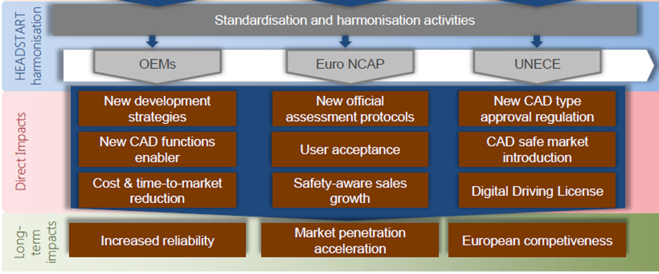
Expected Impact
Testing and validation
  End users: OEMs, Tier1, tools providers
Assessment (Consumer Testing)
  End users: Euro NCAP
Certification (type approval)
  End users: Type approval authorities & Technical services

Slide 12
Cooperate with HEADSTART project
EXPERT GROUP PARTICIPATION
Join as associated partner and our expert group
Join the discussion group of your interest:
  Cyber-security
  Communications (V2X)
  Positioning
  Scenario selection
  Consumer testing (NCAP)
  Type approval
Provide needs and requirements and evaluate project (intermediate) results
JOINT TESTING ACTION
Joint cooperation between both projects for testing validation and certification purposes
Align your project with the harmonized methodology and tools developed within HEADSTART
Become one of our use cases!
Please let us know about your interest and join our distribution list.
Website: www.headstart-project.eu
Contact: info@headstart-project.eu

Slide 13

















HEADSTART Partners

Slide 14
Stay connected with HEADSTART
Visit HEADSTART website
  www.headstart-project.eu
Follow our Social Media:
Reach us via an e-mail:
  info@headstart-project.eu
Sign up to our newsletter:
  https://lists.iccs.gr/wws/subscribe/headstart-news
Get in touch with our partners
@HEADSTART_EU
HEADSTART-PROJECT
HEADSTART project (Group)
@HeadstartEUproject

Slide 15
Name of presenter
Job title affiliation
Contact details
(4 lines max)

