Slide 1

Webinar « State of innovation, stakeholder needs, requirements for Key Enabling Technologies and use case selection »
Jean-Baptiste Coget, VEDECOM

Slide 2
General information and rules
Duration : 40 min presentation + 20 min open questions
This webinar will be recorded and will be published later on the Website https://www.headstart-project.eu/
Any question about the presentation ? Please type it in the “Question bar” with the slide number, it will be answered at the end.
Any technical issue ? Tell us in the chat box
For any other specific request to the project coordinator, please send us an email at : info@headstart-project.eu

Slide 3
Plan of the presentation
General presentation of HEADSTART
I
Introduction to the work package 1
State of innovation and gap analysis
II
Identification of stakeholder needs
Presentation of the results
III
Requirement identification for KETs
Next steps for the project
IV
Functional requirements and use case selection
Report review process
Questions (< 20 min)

Slide 4
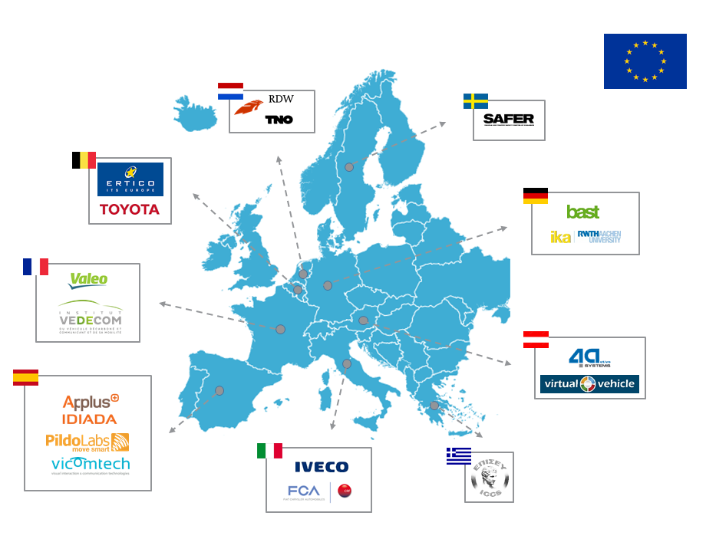



HEADSTART project facts
Call identifier: ART-01-2018
Type: Research and Innovation Action (RIA)
Duration: 01.2019 – 12.2021 (36 months)
Budget: 6M€
Consortium: 17 partners
Coordinator: Applus IDIADA, Mr. Álvaro Arrue, Project Manager
Dissemination Manager: ICCS, Dr. Angelos Amditis, Research Director
Website: www.headstart-project.eu
Social media:
/ HEADSTART_EU
/ HEADSTART-PROJECT
/ HEADSTART project (Group)
/ @HeadstartEUproject

Slide 5

















HEADSTART Partners

Slide 6
Project’s Objectives
HEADSTART will define testing and validation procedures of CAD functions including:
  its key enabling technologies (i.e. V2X communication, cyber-security, positioning)
  by cross-linking of all test instances such as simulation, proving ground and real world field tests
  to validate safety and security performance according to the needs of key user groups (technology developers, consumer testing and type approval)

Slide 7
Use cases and requirements (Work Package 1)
January to September 2019
“State of innovation, stakeholder needs, requirements for Key Enabling Technologies and use case selection”

Slide 8
Use cases and requirements (Work Package 1)
Objective : Develop a comprehensive technical analysis and gap analysis on testing and validation methodologies based on ongoing initiatives worldwide and future pilot tests across Europe.
  Analyse the existing state of the art on validation and testing methodology for CAD
  Identify the needs of stakeholders and target groups and prioritise the use cases arising.
  Identify the functional and technical requirements for KETs (Cyber-security, Positioning, Connectivity).
  Select the most relevant use cases and identify their functional requirements.

Slide 9

I- State of innovation and gap analysis
Topic led by IKA:
Objective: Provide a detailed analysis of the existing state of the art on validation and testing methodology for CAD and identify the main gaps based on the available results.
7 aspects of the state of innovation.
1
Terminology and taxonomy
2
Scenario concepts
Safety assurance for Connected and Automated Driving functions
3
Research projects
4
Initiatives
5
Tools for safety assurance
6
Legislations and boundary conditions
7
Methodology for Safety assurance

Slide 10
1- Terminology and taxonomy
Terminology:
Project analysis : list the terms linked to CAD from 28 projects and standards (DIN-SAE Spec 91381; ISO/PAS 21448 …)
Selection of the most representative terms.
  Some terms have multiple meanings
  The same concept is expressed with different terms
Criteria for selecting terms and definition :
  Relevance to the scope of HEADSTART
  Generality and representativeness
  Clarity and conciseness
A unified and unambiguous glossary has been defined with ~45 terms
Taxonomy for automation levels:
Most projects follow the SAE - J3016 taxonomy
Other model found : BASt and NHTSA
Level | SAE - J3016 | BASt | NHTSA
0 | No Automation | Driver Only | No Automation
1 | Driver Assistance | Assisted | Function Specific Automation
2 | Partial Automation | Partly Automated | Combined Function Automation
3 | Conditional Automation | Highly Automated | Limited Self-Driving Automation
4 | High Automation | Fully Automated | Full Self-Driving Automation
5 | Full Automation | / | /

Slide 11










2- Scenario concepts
Objective : Definition of driving scenarios
Scenario concepts detailed form several research projects :
3- Research projects
Objective : Identify CAD research projects of interest for HEADSTART
38 projects identified
Focus on HEADSTART’s Key Enabling Technologies
  V2X communication ➔ 9 projects
  Cyber security ➔ 7 projects
  Positioning ➔ 8 projects
Focus on CAD-Test-definition &Testing-activities ➔ 22 projects

Slide 12


























3- Research projects
Other projects:
HoliSec
MuCCA
PROSPECT
ESCAPE
Program (SAFER)
Cooperative driving at traffic intersections
Grand Cooperative Driving Challenge
Coordination of CAVs over 5G
ADAS & me

Slide 13





















4- Initiatives
Other relevant initiatives
Objective : Identify CAD initiatives of interest for HEADSTART
22 relevant initiatives found
Classification into several topics:
Manufacturers associations
Public authorities
KETs
Consumer testing
Nouvelle France Industrielle (NFI)

Slide 14
4- Initiatives

Slide 15
5- Tools for safety assurance
Objective : List the main tools relevant for HEADSTART
Four categories of tools of interest for HEADSTART:
Annotation tools
Addition of relevant metadata
Video Annotation tools
Annotation tools for 3D content
Web platforms offering data annotation services
Web platforms offering data annotation services
Annotation tools from initiatives
…
Recording tools
Synchronous raw data acquisition
RTMaps
Polysync Core
IDIADA IDAPT
LogicBricks logiRECORDER 3.0
…
Simulation tools
NVIDIA DRIVE
Microsoft AirSim
Simcenter Prescan
CARLA
IPG Carmaker
rFpro
VIRES VTD
...
Dummies
Global Vehicle Target (GVT)
Pedestrian Target (PT)
Bicyclist Target (BT)
…
Software to control dummies
Robot Operating System (ROS)
Automotive Data and Time-Triggered Framework (ADTF)
…
WP1 Webinar

Slide 16
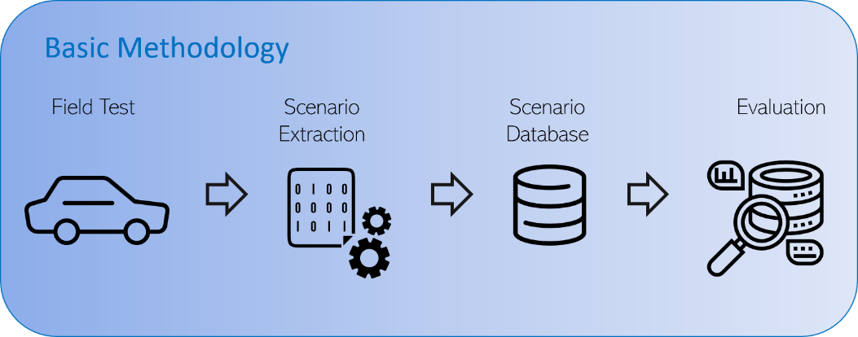
6- Legislations and boundary conditions
Objective: Assess the current legislation on type approval for CAD functions, identify the relevant legislations for HEADSTART.
56 document reviewed from European and non-European Legislation, National Legislation, Standards and Guidelines
7- Methodology for Safety assurance
Objective: Define the methodologies for safety assurance of automated driving functions
FOT
Naturalistic data

Slide 17
II- Identification of stakeholder needs
Topic led by VEDECOM:
Objective: Identify the needs on methodologies and procedures (demonstrations, certifications), tools and standards from the viewpoint of different stakeholders and user groups.
Topics of interest
Types of stakeholders
1
Use cases and scenarios
OEMs
2
Safety assessment and safety case
Automotive suppliers / Tier 1
Collection of needs
3
Testing
F2F / phone interviews
Targeted survey / Email
Online surveys
Public authorities / Policy makers
4
Certification / type approval
Consumer organisations
5
Consumer testing
Research institutes
6
Testing goals for Positioning, V2X Communication and Cybersecurity
Universities

Slide 18
II- Identification of stakeholder needs
Quantitative results for the 6 interview topics:
+14 online surveys answered
Type of stakeholder | F2F / phone interviews | Targeted survey / Email | Total
OEMs | 5 | 3 | 8
Automotive suppliers / Tier 1 | 1 | 2 | 3
Public authorities / Policy makers | 3 | 1 | 4
Consumer organisations | 0 | 1 | 1
Research institutes | 11 | 16 | 27
Universities | 0 | 1 | 1
Total | 20 | 24 | 44

Slide 19
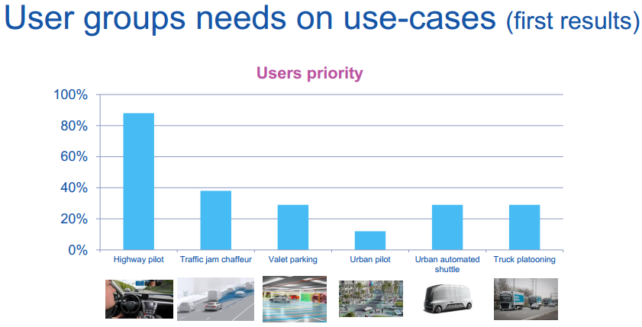
1- Use cases and scenarios
Objective: Identify the priority use cases for stakeholders
Survey results for use cases:
  User groups needs on use cases have been presented at an expert workshop in Eindhoven in June 2019
  The open discussions with the stakeholders confirmed that « urban pilot » is not a priority for them.

Slide 20
2-Safety assessment and safety case
Objective: Identify the main risks introduced by CAD functions and the means to improve safety
Main risks introduced by CAD functions:
  Misusing the system (ex: no respect of the ODD)
  Encountering an unknown scenario
  Software update and bugs
Best approach to take to ensure safety:
  Scenario-based approach
  Validation ➔ Combination of different test instances (e.g. simulation, test track, open road)
  Procedure and tools ➔ Safety Of The Intended Functionality (ISO/PAS 21448) + ISO 26262
  No current legislation for the safety of CAD functions of level 3+
  Criminal activities / cyber-attack
  Loss of positioning / Connectivity
  …

Slide 21
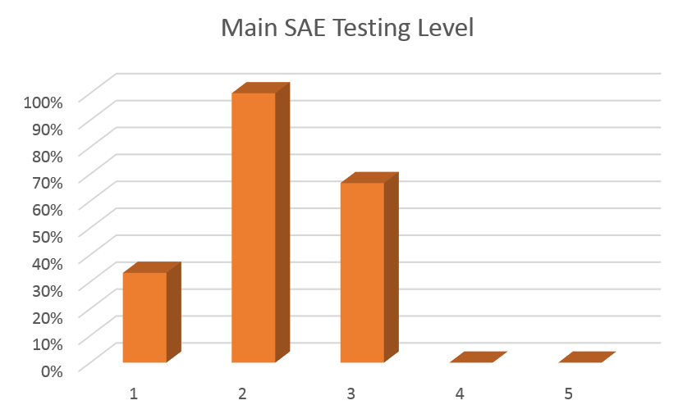
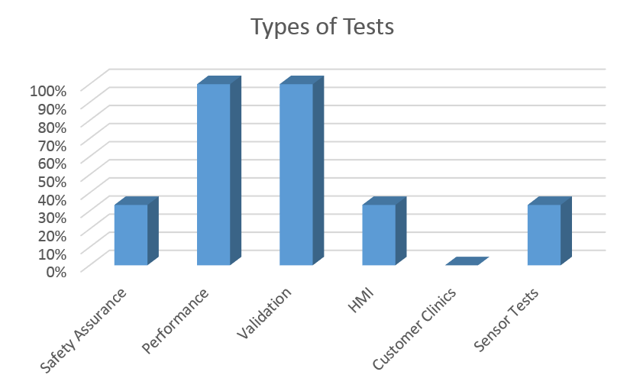
3- Testing
Objective: Identify the needs on testing CAD functions
  Most of the testing is taking place on SAE levels 2 and 3 but will soon evolve to SAE level 3+
  Testing organisations are focusing on performance and validation tests.
  No fixed methodologies stated except from protocols like EuroNCAP
  Need for a common methodology and protocol

Slide 22
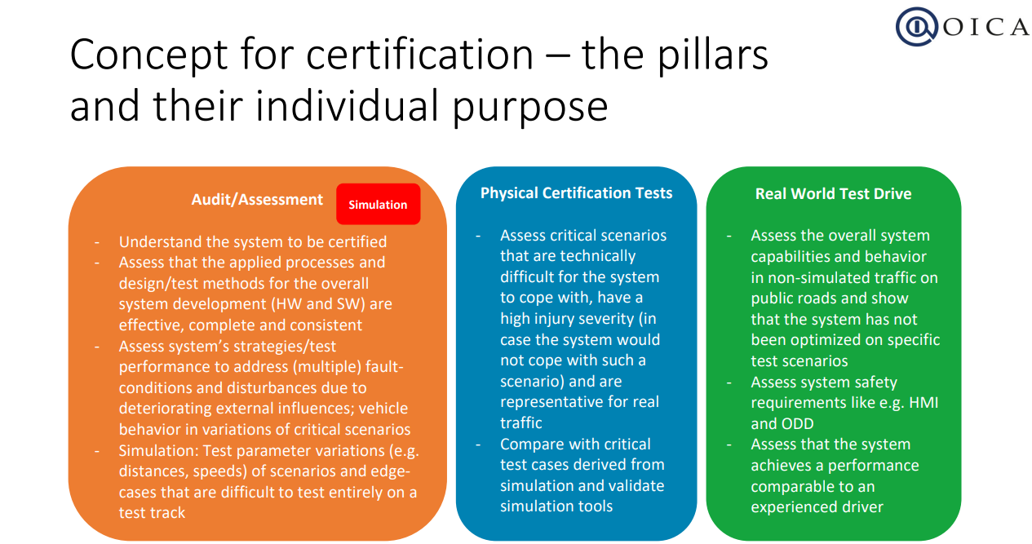
4- Certification & type approval
Objective: Identifying the type approval needs for testing
e.g. International Organization of Motor Vehicle Manufacturers (OICA) 3 pillars concept for certification

Slide 23
5- Needs on consumer testing
Consumer testing ➔ one final user of the HEADSTART methodology.
Strictly focus on functions that are already available on the market (SAE level 2)
Goal for consumer associations ➔ Correctly communicate the capabilities and limitations of the functions to the final customer.
Type approval
Safety Assurance: “How many lives could be saved and accidents avoided by the AD function”
Consumer testing
Safety Benefit: “The function is able to perform as expected, without adding risk to the driver or other road users”

Slide 24

5- Needs on consumer testing
Euro NCAP 2025 https://cdn.euroncap.com/media/30700/euroncap-roadmap-2025-v4.pdf
New features to be tested in Euro NCAP:
Driver Monitoring (2020)
Automatic Emergency Steering (2020, 2022)
Autonomous Emergency Braking (2020, 2022)
V2x (2024) 10SECONDARY SAFETY
Whiplash/Rear-end Crash Protection (2020)
Pedestrian and Cyclist Safety (2022)
Tertiary Safety
Rescue, Extrication and Safety (2020)
Child Presence Detection (2022)
Other Features:
Automated Driving
Cyber Security
Trucks and Powered two-wheelers

Slide 25
6- Needs on testing Key Enabling Technologies
Objectives:
  Identification of the best use cases to test Key Enabling Technologies
  Identification of specific testing needs for KETs
Main use cases for testing KETs identified :
Highway Pilot (Level 4)
Urban and Suburban Pilot (Level 4)
Highly automated freight vehicles in Fully Automated Urban Vehicles (Level 5)
Automated PRT/Shuttles on dedicated roads (Level 4)
Automated Bus Chauffeur (Level 3)
Autonomous private vehicles on public roads (Level 5)
Automated Truck Platooning (Level 2)
Highly automated freight vehicles in Hub-to-Hub operation (Level 4)
Urban and Suburban Pilot (Level 4)
Traffic Jam Chauffeur (Level 3)

Slide 26
III- Requirement identification for KETs
Topic led by SAFER:
Objective: Identify and Compile technical and functional requirements for HEADSTART’s Key Enabling Technologies (Positioning, V2X communication, Cyber-security) to achieve safe automated functions.
Positioning / V2X communication / Cybersecurity
Analysis of stakeholder needs for KETs
Functional requirements at vehicle level
Technical constrains at vehicle component level
Safety requirements for road-users
Potential physical constrains on test tracks
How the technical requirements are expected to be partly verified by computer tools
Technical feasibility
KETs relevant projects from the state of the art analysis
(…)

Slide 27
Requirements for Positioning
Functional requirements at vehicle level
  The system shall be able to provide positioning data at 10 Hz.
  Detect and evaluate GNSS uncertainty.
  …
Technical constrains at vehicle component level
  The system shall be able to provide longitudinal and lateral positioning with 10 cm accuracy
  .…
Safety requirements for road-users
  The vehicle must be possible to reach a safe state when positioning is degraded or lost
  …
Potential physical constrains on test tracks
  The outdoor test track must allow easy GNSS connection
  A HD map of the test track area must be available.
  How to test high-precision absolute navigation with confidence (not to measure GNSS with GNSS)
  …
How the technical requirements are expected to be partly verified by computer tools
  Proper simulation under various weather conditions
  …

Slide 28
Requirements for V2X communication
Functional requirements at vehicle level
  Connected infrastructure, e.g., traffic lights, should be able to communicate through ITS-G5, 4G/LTE, 5G/LTE.
  The system must support high connection density for congested traffic.
  …
Technical constrains at vehicle component level
  One Road Side Unit shall be able to communicate with up to 200 User Equipment (UE).
  …
Safety requirements for road-users
  A vehicle must be able to reach a safe state if it has a critical failure (engine failure or loss of V2X communication).
  …
Potential physical constrains on test tracks
  If V2X communication testing is carried out in open air, no other radio transmission must influence the testing.
  If V2X communication testing is carried out in a shielded chamber, no other radio transmission must exist.
  …
How the technical requirements are expected to be partly verified by computer tools
  The tool should be able to define and re-use test sequences of V2X messages
  …
Technical feasibility
  V2X is still in being developed and devices meeting the requested requirements may not be available
  To ensure safety when testing of non-deterministic algorithms (e.g. High speed Truck Platoon and AI). Some scenarios will be to dangerous to test out with real vehicles.
  …

Slide 29
Requirements for cyber security
Functional requirements at vehicle level
  V2X message reception shall be signed by a trusted third-party (message shall have valid and verified certificate and signature).
  …
Technical constrains at vehicle component level
  Measures should be applied for all components in the system (e.g. vehicles involving network and infrastructure) to ensure an end-to-end cybersecurity.
  …
Safety requirements for road-users
  N.A
Potential physical constrains on test tracks
  Potential cyber-attacks shall be dually analysed; from the “Defenders” or “Blue Team” and the “Attackers” or “Red Team” point of view.
  …
How the technical requirements are expected to be partly verified by computer tools
  Performed cyber security testing (e.g. TARA analysis, Penetration testing, Fuzz testing)
  …
Technical feasibility
  The function has been developed following existing best practices for cybersecurity.
  Sensitive to attack GNSS systems in non-shielded environment.
  …

Slide 30
IV- Functional requirements and use case selection
Topic led by SAFER:
Objectives:
Compile the requirements for use cases and functionality to demonstrate safe CAD functions
Classify use cases, functional requirements and scenarios described in the previous tasks
Determine the most important use cases and for each of them, the appropriate CAD functions
  Description of each preselected use case with representative scenarios,
  Relevance ranking of the use cases based on a survey
Collection of identified requirements on use cases w.r.t. project goals
Classification/
Assessment of use cases
Selection
Functional Requirements for selected use cases
Use-cases from stakeholder needs

Slide 31
Requirements for selecting use cases
Categories of requirements:
Requirements on testability of the KETs
  Positioning
  V2X Communication
  Cybersecurity
Requirements regarding physical testing
  Proving ground testing
  Field operational tests
Requirements regarding model-based testing
Definition and availability of scenarios
Requirements on collaboration partners
Relevance to key user groups
  OEMs, Tier1s
  Type approval authorities
  Consumer Testing

Slide 32
Use case ranking
Requirements for testing KETs
Requirements for testing
Availability of Scenarios ➔
Collaboration partners for this use case ➔
Relevance to key user groups

Slide 34
Next steps for the project
January to September 2019
“State of innovation, stakeholder needs, requirements for Key Enabling Technologies and use case selection”

Slide 35
Next steps for the project
2019
2020 - 2021
Throughout the project
“State of innovation, stakeholder needs, requirements for Key Enabling Technologies and use case selection”
“Methodologies, procedures, demonstrations …”
“Expert network and international cooperation through Events, Workshops and Webinars”
Notes:
Establish a global testing and validation methodology
Extend this methodology to Positioning, V2X communication and Cybersecurity
Apply the methodology to the selected use cases
Define procedures and processes

Slide 36
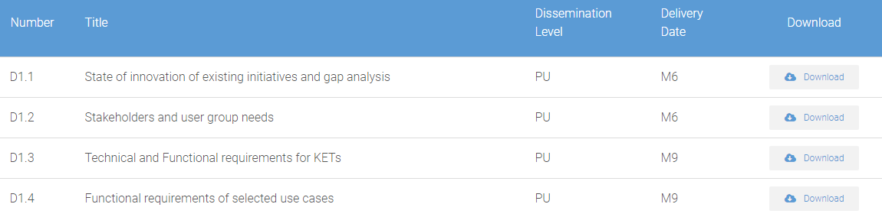
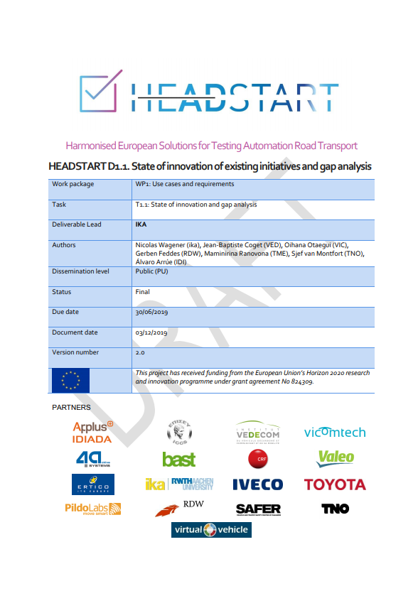
Next steps: Report review and update
Report review process ➔ Four deliverables written
Download the deliverables : https://www.headstart-project.eu/results-to-date/deliverables/
Provide your comments to info@headstart-project.eu

Slide 37
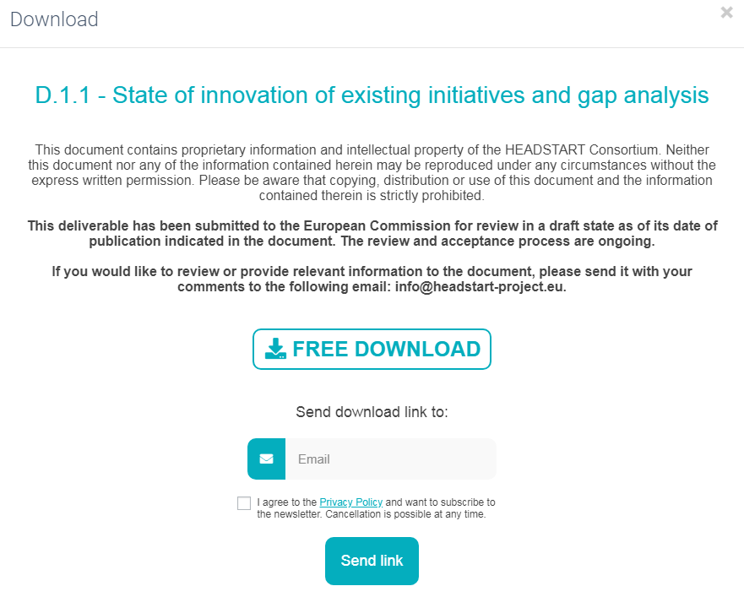
Next steps: Report review and update
Download the deliverables : https://www.headstart-project.eu/results-to-date/deliverables/
Provide your comments to info@headstart-project.eu

Slide 38
Questions
Questions from the chat (20 min)
Notes:
1) What KET is greatest challenge to test?
2) Do you think Cyber-Security will be regulatory? i.e. will EU issue a directive?
3) We accept a certain level of risk in traffic. In Sweden it is 300 deaths per year, how would that translated to Automated drive?

Slide 39
Cooperate with HEADSTART project
https://www.headstart-project.eu/get-involved/
EXPERT GROUP PARTICIPATION
Join as associated partner and our expert group
Join the discussion group of your interest:
  Cyber-security
  Communications (V2X)
  Positioning
  Scenario selection
  Consumer testing (NCAP)
  Type approval
Provide needs and requirements and evaluate project (intermediate) results
JOINT TESTING ACTION
Joint cooperation between both projects for testing validation and certification purposes
Align your project with the harmonized methodology and tools developed within HEADSTART
Become one of our use cases!
Please let us know about your interest and join our distribution list.
Website: www.headstart-project.eu
Contact: info@headstart-project.eu

Slide 40
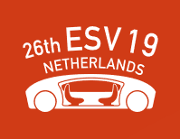
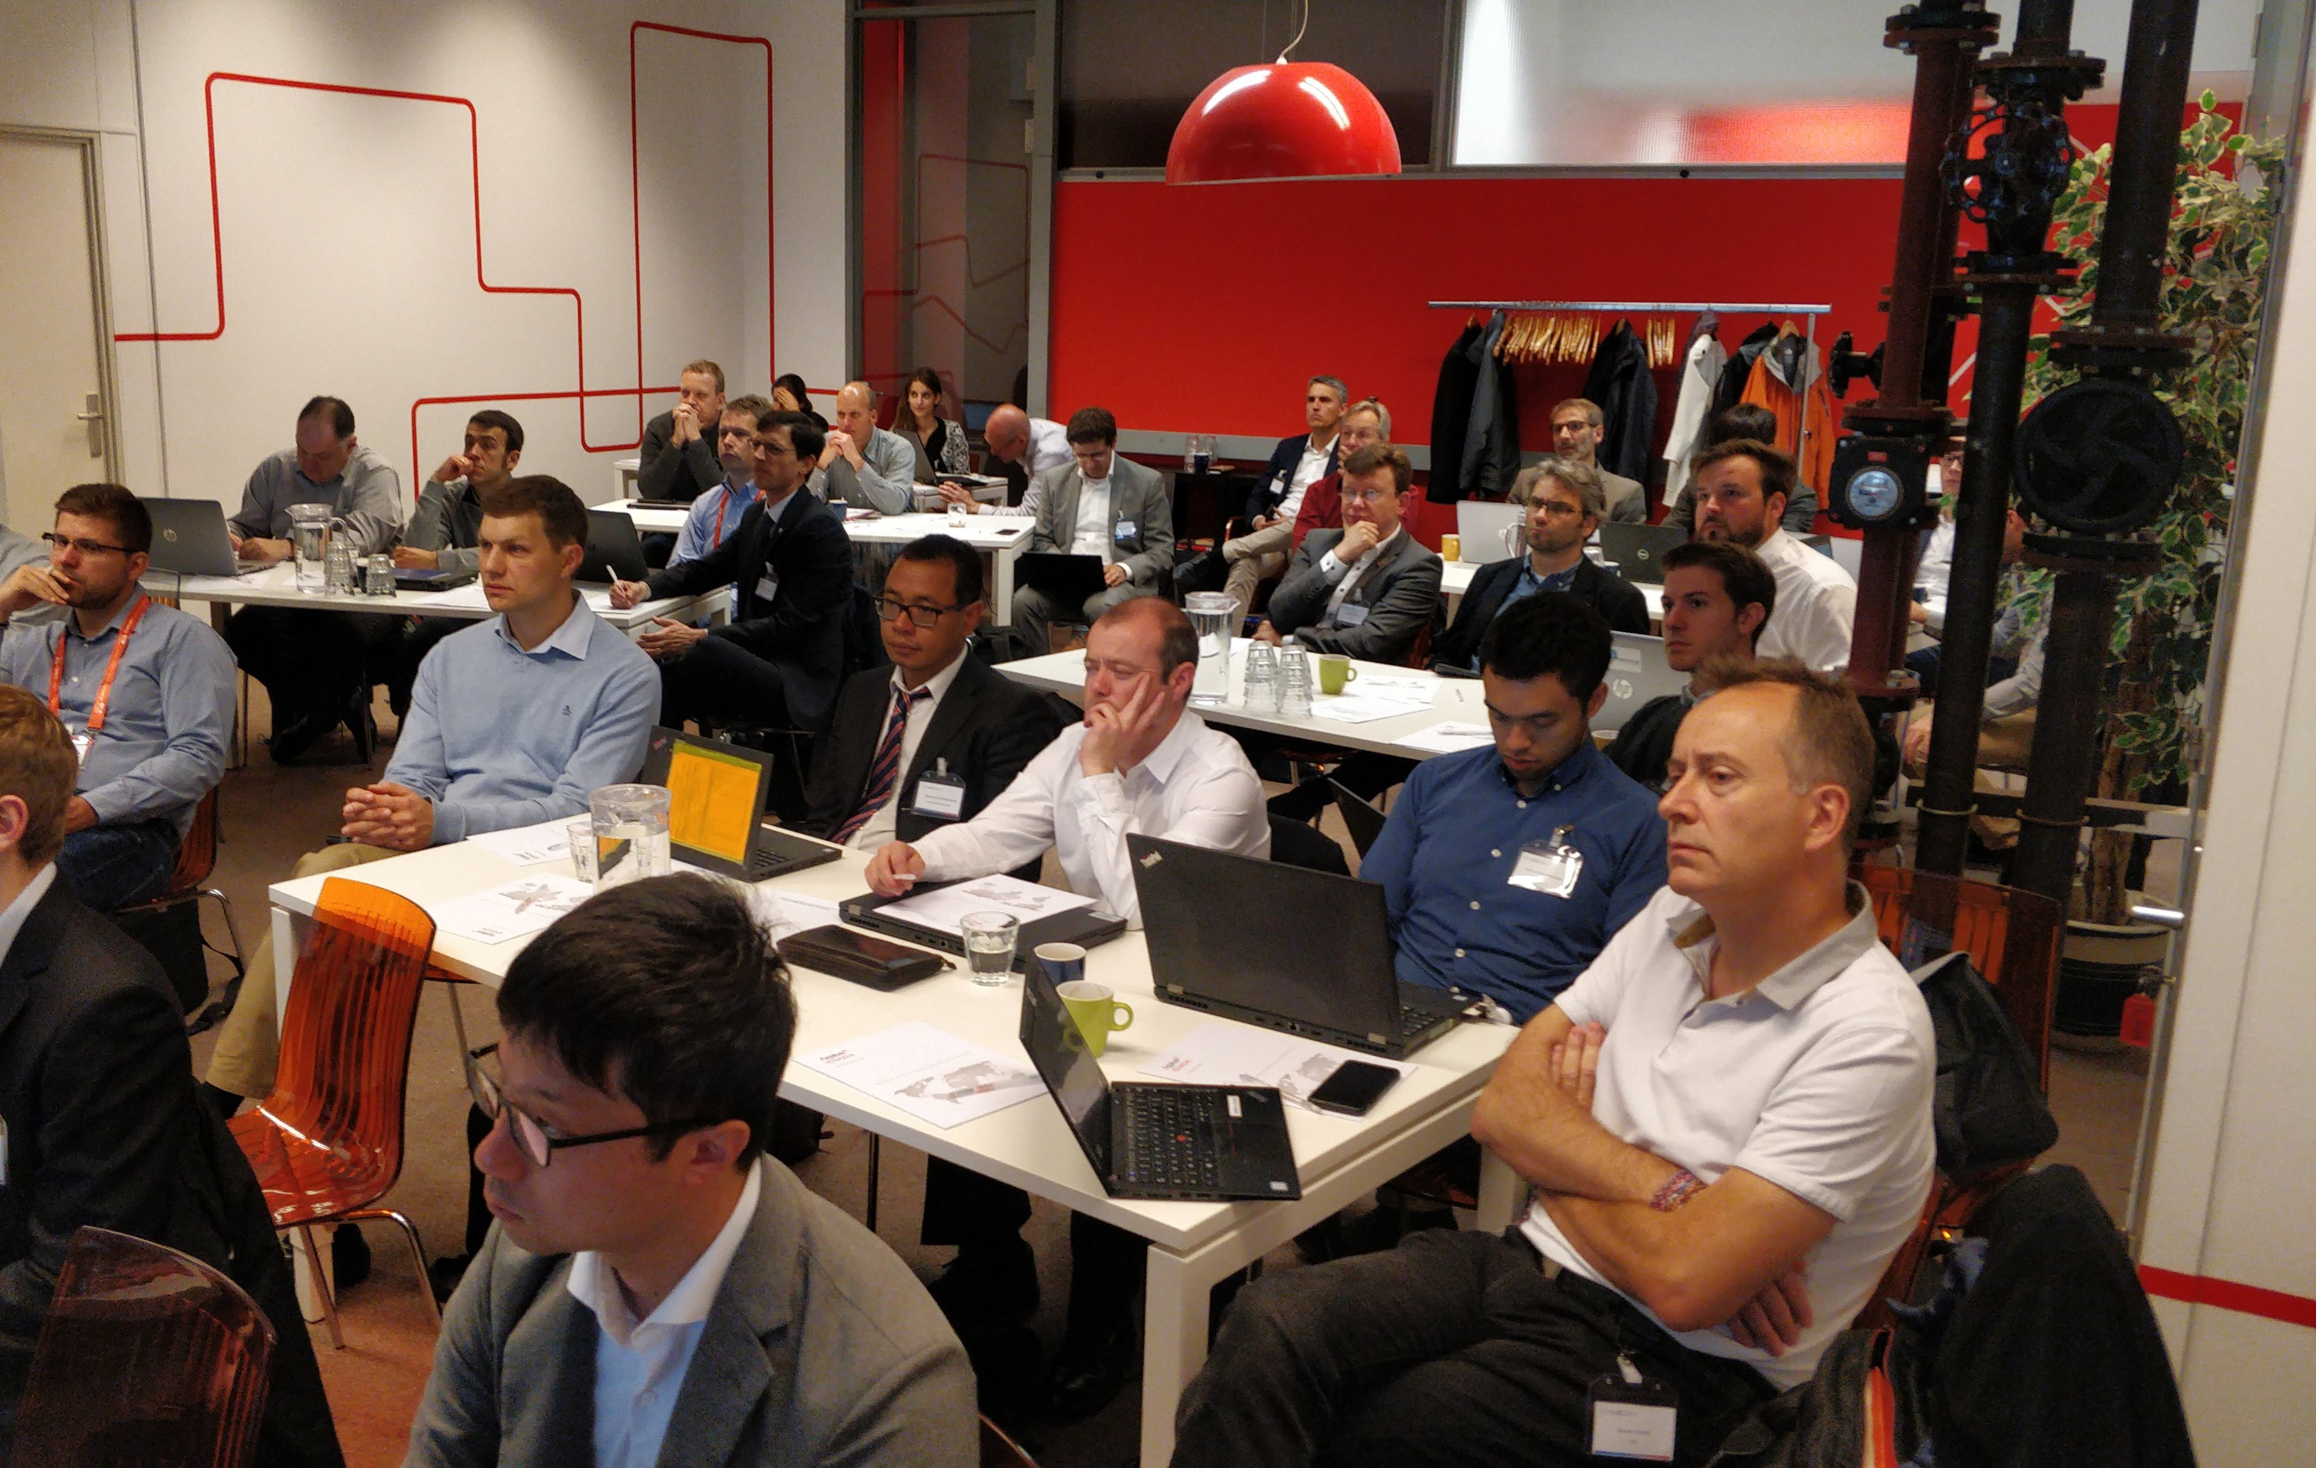
Workshop on new approaches for ´Scenarios selection´ and ´Consumer Testing´
    Summary of results
    Overview of initiatives worldwide
      Euro NCAP, JARI, etc…
    Use case prioritization by stakeholders
    Prioritization of test instances by type of testing needs (development, consumer testing, type approval)
    Discussion on type approval (sub) procedures

Slide 41
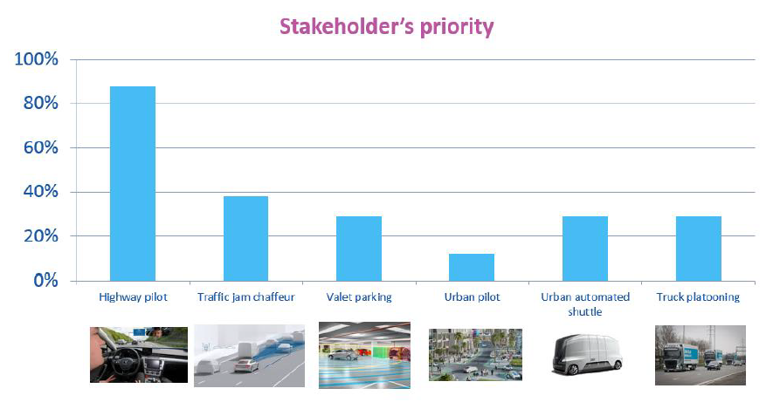
Workshop on new approaches for ´Scenarios selection´ and ´Consumer Testing´

Slide 42
Jean-Baptiste Coget
RAMS Engineer at VEDECOM
jean-baptiste.coget@ext.Vedecom.fr

